Slide 1
ACUTE CORONARY SYNDROME RISK PREDICTION MODEL AND SURVIVAL ANALYSIS
TEAM NAME: PGDBA_IIT_IIM_ISI

Slide 2
Agenda
Problem Description
Solution framework
Exploratory Data Analysis
Machine Learning Models and User Interface
Survival Analysis and Models
Web-Application
Enhancements in Pipeline
Future Enhancements

Slide 3
Solution Framework
Machine Learning Models ( Server )
Tests
Tests
Web Application (Client)
Patient
Doctor
Patient dashboard
Doctor dashboard
Python and Flask
Backend

Slide 4
Data Description
Registration
Patient ID | Gender | Age | Registration_Date
Physical Examination
Height | Weight | BMI
Demographic Details
Demographic Details | Current_Employment | Salary
History of Earlier Cardiovascular Events/Interventions, Risk Factors
MI | MI_YearMostRecent | Stable_AAngina | PTCA | CABG | Positive_TMT | CAG_Evidence_of_CAD | Family History_of Coronary Heart Diseases or Stroke | Family History of Other_Cardiovascular_Events | Hypertension | Diabetes | Dyslipidemia | SBP | DBP | Smoking_Status | Current/Past smoker | Tobacco_Status
 | Revascularization Therapy |  |  |  |  |  | In admisiion Events |  |  |  |  |  |  |  | Final diagnosis
Aspirin prescribed prehospitalization | Thrombolysis | ECHO | LVEF_Ejection_Fraction | Angiography | PTCA | CABG | Reinfarction | Stroke | LV_Failure | Recurrent_Ischemia_Angina | Cardiac_Arrest | Cardiogenic_Shock | Pulmonary_Embolism | Bleeding_Requiring_Transfusion | Death | Discharged Alive | MI | MI_Yes_Type | Location_MI | Payment_Mode
Provisional Diagnosis | At the time of Presentation |  | ECG | Laboratory |  |  | Cardiac Enzymes
Provisional_Diagnosis_On_Admission | Heart_Rate_per minute | Kilip_Class | ECG_Abnormal_For_Ischemia | _Creatinine_mg_Per_dl | Random_Glucose_mg_Per_dl | Fasting_Glucose_mg_Per_dl | Creatinine Phosphokinase (CPK) | CPK_Quantitative_Value | CKMB | CKMB_Quantitative_Value | Troponin | Troponin_I_OR_T | Troponin_Quantitative_Value
Presentation of Patient to Registry Hospital: Pathway used by Patient
Symptom To Emergency Door Time | Transfer_Mode | Transfer_From another hosp

Slide 5






Exploratory Data Analysis
MACE data :
Training data for classification
Data corresponding to MI : STEMI, NSTEMI
Data corresponding to Non-MI: Unstable Angina
Data for Survival Analysis
Survival analysis done assuming that patients have MI
Feature Importance :
Subjective opinions from experts
Corroboration from data analysis
Discretization of features in ordinal manner
Data
Exploratory Analysis
Model data creation
Modeling
Validation
Output
ICMR data
Trend Analysis
Box Plot
Feature Engineering, Discretization
Machine learning and survival analysis models
Constrained by the amount of data
CVD risk probability
Hazard function and survival plots

Slide 6
Exploratory Data Analysis
Total features in the data were around 64 under 12 data type with 100 data points
Necessary to club features for analysis. Final Count (22 plus one for response)
Response Variable for Machine Learning model is to predict MI (N-Stemi & Stemi) or non-MI (Unstable Angina)
Most of the features were Discretised (Need of the ICMR)
Hugely Imbalanced data set. One case of death so Survival analysis not possible on this data.
Survival Analysis done using University of Massachusets dataset.
Gender | Age | BMI | Demographic Details | Current_Employment | Salary Range | MI History | History | Hypertension | Diabetes | Dyslipidemia | SBP levels | DBP levels | Smoking_Status | Tobacco_Status | Heart rate levels | Kilip_Class | _Creatinine_mg_Per_dl | CPK_Quantitative_Value | CKMB_Quantitative_Value | Troponin_Quantitative_Value | In admisiion Events | MI_Yes_Type
0 | 3 | 2 | 1 | 3 | 1 | 0 | 0 | 0 | 0 | 0 | 2 | 3 | 0 | 0 | 2 | 2 | 1 | 0 | 0 | 0 | 0 | 1
1 | 3 | 2 | 1 | 1 | 1 | 0 | 0 | 0 | 0 | 1 | 3 | 3 | 0 | 0 | 1 | 1 | 1.6 | 0 | 0 | 0 | 0 | 0
0 | 0 | 0 | 0 | 3 | 0 | 0 | 0 | 1 | 1 | 1 | 3 | 2 | 0 | 0 | 1 | 1 | 1.3 | 96 | 95 | 0 | 1 | 2

Slide 7
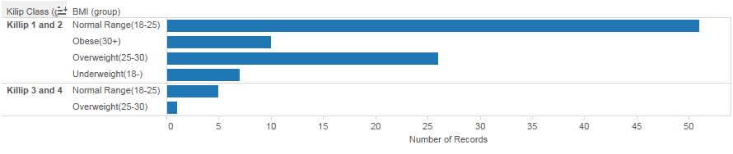
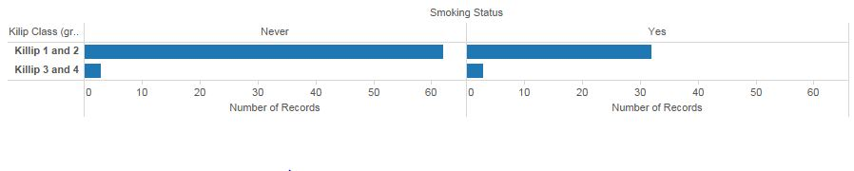
Exploratory Data Analysis (Contd’)
Some of the data analysis done-
Kelip Types | Underweight (18-) | 18-25 | 25-30 | 30+
Kelip 1 and 2 | 4 | 54 | 26 | 10
Kelip 3 and 4 | 0 | 5 | 1 | 0
MI TYPE | No. of Patients
NSTEMI | 25
STEMI | 64
UNSTABLE ANGINA | 11
Kelip Types | Never smoked | Smoked in the past or current
Kelip 1 and 2 | 62 | 32
Kelip 3 and 4 | 3 | 3

Slide 8
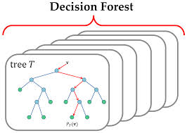
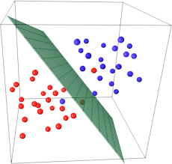
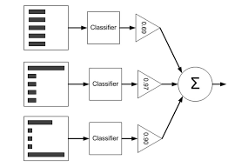
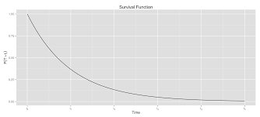
Machine Learning Models and User Interface
RISK PREDICTION MODELS
SVM
ADA BOOST
Input Data
Age, Blood Pressure, etc. variables for each patient
SURVIVAL ANALYSIS MODEL
Classification of MI type for each patient- Stemi MI, N-Stemi MI and Unstable Angina
Survival Probability, i.e., Probability that a patient survives until a particular time instant
Output Data

Slide 9
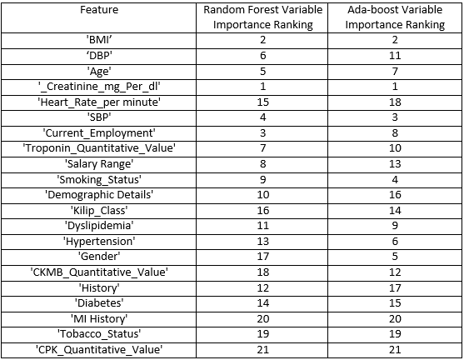
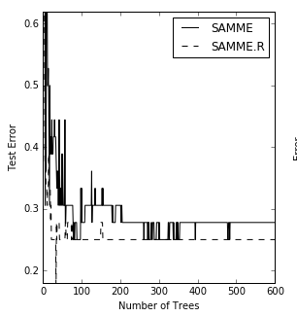
FEATURE IMPORTANCE FOR MYOCARDIAL INFARCTION PREDICTION
**Feature Importance
for classification
Ensemble based tree based models – Random Forest and Adaboost classifier
Feature Importance based on algorithmic decision and subject matter experts
Adaboost Classifier performed better with better performance on test set.

Slide 10
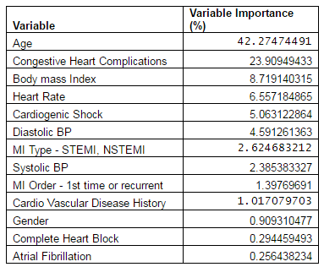
FEATURE IMPORTANCE FOR SURVIVAL ANALYSIS
Survival analysis on given small data set is not possible as death event occurrence is only for one data point.
We have used the data set from University of Massachusets
This dataset comprises of features which are distinct from given MACE dataset
Hierarchical Bayes model using Cox Proportion Hazards for predicting the survival and hazard curves for each patient.
**Variable Importance
for survival analysis

Slide 11
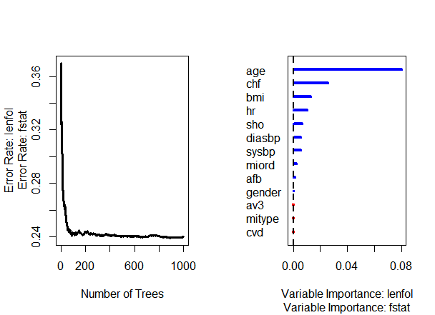
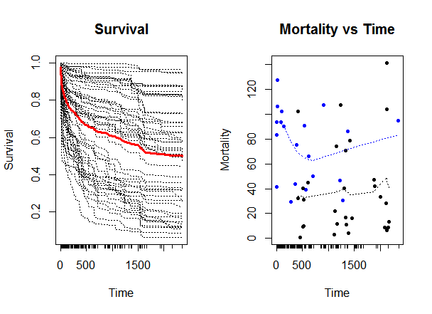
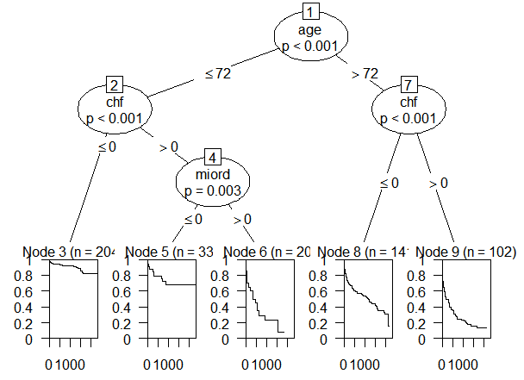
Survival Trees

Slide 12
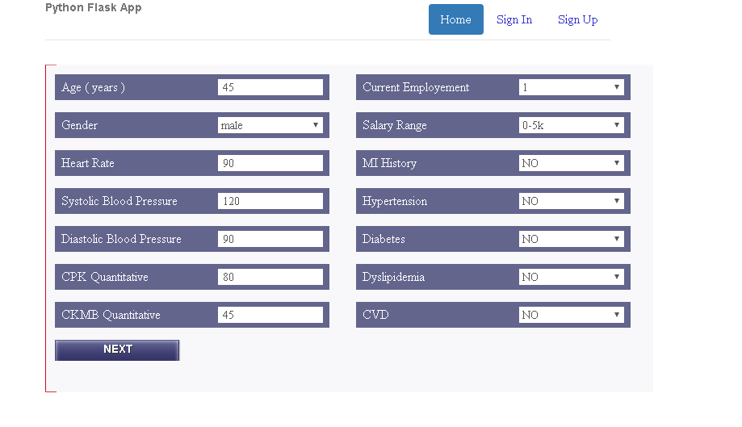
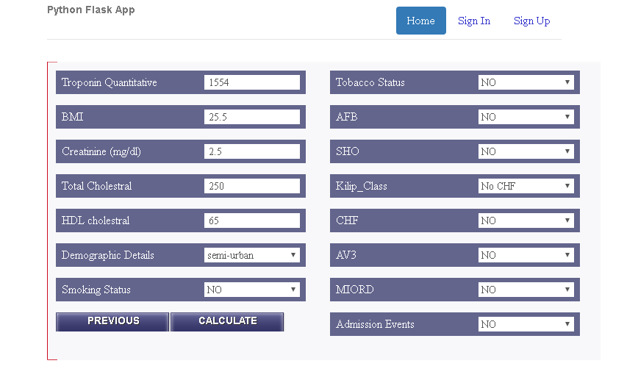
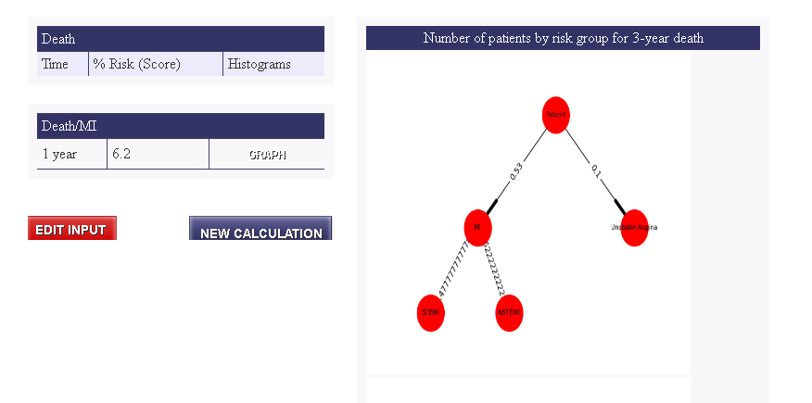
Web-Application
Input :
Output:

Slide 13
Enhancements in pipeline
Lazy Learning : Follow-up and New patient data incorporated into the model.
Missing and unbalanced data.
Summary Statistics
Clustering patients having similar survival distribution
Comparing survival distribution among group of patients
Patient Dashboard
Population based studies on Survival times and variable importance

Slide 14
Future Enhancements
Integration with Images : Convolutional neural network
Integration with Aadhar
Insurance Implications
BPL targeting for insurance coverage
Efficacious healthcare
Distributed Framework
Analysis using Weighted Feature
Outlier Detection
The conundrum of multiple surgeries and survival rates

Slide 15
THANK YOU !!!

